Slide 1
Machine Learning with SQL Server
Part 2 – Preparing the data
Damian Widera

Slide 2
Damian Widera
marcin.szeliga@datacommunity.pl

Slide 3

Agenda
Data understanding
Data preparation
Data transformation
Feature selection
Feature engineering
By Kenneth Jensen - own work based on: ftp://public.dhe.ibm.com/software/analytics/spss/documentation/modeler/18.0/en/ModelerCRISPDM.pdf (Figure 1), CC BY-SA 3.0, https://commons.wikimedia.org/w/index.php?curid=24930610

Slide 4
Before we start

Slide 5
Before we build the model …
Data understanding
Data preparation
Data transformation
Feature selection
Feature engineering
Many steps:
Data import
Styling
Metadata and data types
Duplicate detection
Dataframe manipulation
Outlier detection
Variable generation and manipulation
Preparation of data for modeling

Slide 6
Tools
Jupyter Notebook
Spyder
Visual Studio Code
SSMS

Slide 7
Installation
Machine Learning Server includes open-source and Microsoft-specific Python packages for modeling, training, and scoring data for statistical and predictive analytics.
For classic client-server configurations, where multiple clients connect to and use a remote Machine Learning Server, installing the same Python client libraries on a local workstation enables you to write and run script locally and then push execution to the remote server where data resides.
This is referred to as a remote compute context, operant when you call Python functions from libraries that exist on both client and server environments

Slide 8
Microsoft Python packages
revoscalepy
microsoftml
azureml-model-management-sdk
pre-trained models
SQL Server 2017 Machine Learning Services (In-Database)
Machine Learning Server for Hadoop

Slide 9
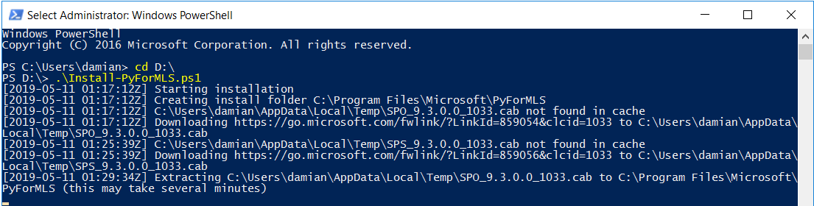
Installation
How to install Python client libraries for remote access to a Machine Learning Server
https://docs.microsoft.com/en-us/machine-learning-server/install/python-libraries-interpreter

Slide 10
Understanding the data

Slide 11
Understanding the Data
Before you start working with data for a machine learning project, it is vital to understand what the data is, and what we want to achieve.
Without it, we have no basis from which to make our decisions about what data is relevant as we clean and prepare our data

Slide 12
Data preparation

Slide 13
Select the Data
Only subset of data
More data is better
Good data source
Confidence?
Exclude

Slide 14
Data pre-processing
Data Source
Initial format
Desired format
Missing data handling
What are the options?
Data Sampling
Only subset of data

Slide 15
Data pre-processing – missing data
Drop data in the row
NULL (NaN) value - delete
Drop data on a column level
As above but from a column perspective
Filter cut-off
Thershold that says how many non-NaN values must be in a row
Imputer – automatically change missing data according to a strategy:
Mean, Median, Most Frequent, Constant, Min, Max

Slide 16
Data pre-processing
Removing duplicates
By deleting a row
By delete data by analyzing a column
Delete a row
Works like a SELECT DISTINCT from all features
Delete data by analyzing a column
Column data is analyzed. Duplicate values are removed by a meaning that the row is removed

Slide 17
Outlier detection
An outlier is an observation that deviates drastically from other observations in a dataset
Occurrence:
Natural, Bill Gates's income
Error, impossible value in the data set - Heart Rate 1681 (should be 168.1)
How bad it is
Naturally occuring:
Not necessarily problematic
But can skew your model by affecting the slope
Error
Indicative of data quality issues
Treat in the same way as a missing value, i.e. use imputation

Slide 18
Tukey IQR
Identifies extreme values in data
Outliers are defined as:
Values below Q1-1.5(Q3-Q1) or above Q3+1.5(Q3-Q1)
Standard deviation from the mean is another common method to detect extreme values
But it can be problematic:
Assumes normality
Sensitive to very extreme values

Slide 19
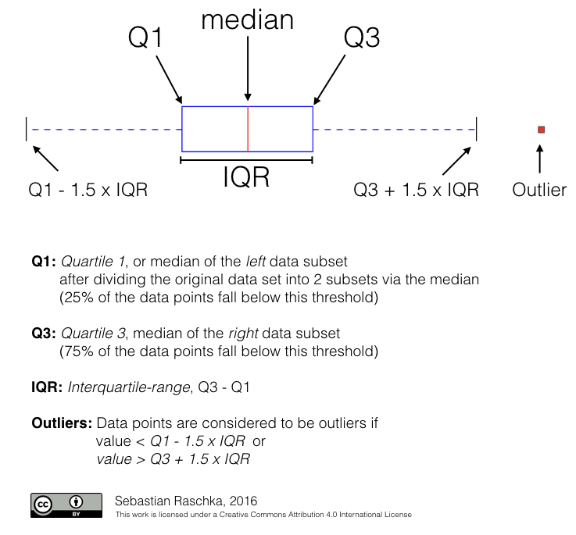
Tukey IQR

Slide 20
Kernel Density Estimation
Non-parametric way to estimate the probability density function of a given feature
Can be advantageous compared to extreme value detection (e.g. Tukey IQR)
Capures outliers in bimodal distributions

Slide 21
Kernel Density Estimation
Non-parametric way to estimate the probability density function of a given feature
Can be advantageous compared to extreme value detection (e.g. Tukey IQR)

Slide 22
Label encoding
Refers to converting the labels into numeric form so as to convert it into the machine-readable form.
Machine learning algorithms can then decide in a better way on how those labels must be operated.
It is an important pre-processing step for the structured dataset in supervised learning.

Slide 23
One Hot Encoding
One hot encoding is the most widespread approach
It works very well unless your categorical variable takes on a large number of values
One hot encoding creates new (binary) columns, indicating the presence of each possible value from the original data. Let's work through an example

Slide 24
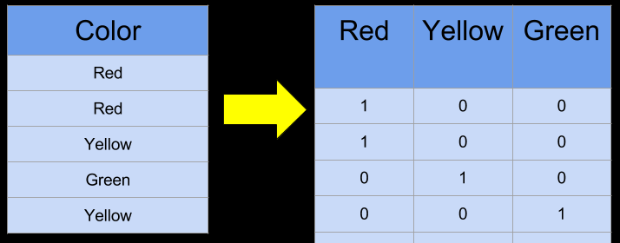
One Hot Encoding

Slide 25
Transformations
Scaling
Col1 (mm) = 4890 mm
Col2 (km) = 1.09 km
Decomposition
Datetime -> date, time
Aggregation
Length, Width -> Area

Slide 26
Scaling, Binarization, Normalization
MinMax Scaler
Standard Scaler
Normalize Data
Binarize Data

Slide 27
MinMax Scaler
Transforms features by scaling each feature to a given range
This estimator scales and translates each feature individually such that it is in the given range on the training set, e.g. between zero and one
X_std = (X - X.min(axis=0)) / (X.max(axis=0) - X.min(axis=0))
X_scaled = X_std * (max - min) + min

Slide 28
Standard Scaler
Standardize features by removing the mean and scaling to unit variance
The standard score of a sample x is calculated as:
z = (x - u) / s
u is the mean of the training samples or zero if with_mean=False,
s is the standard deviation of the training samples or one if with_std=False.
Centering and scaling happen independently on each feature by computing the relevant statistics on the samples in the training set. Mean and standard deviation are then stored to be used on later data using the transform method

Slide 29
Normalize Data
Normalize samples individually to unit norm.
Every observation is normalized to have the length 1
Each sample (i.e. each row of the data matrix) with at least one non zero component is rescaled independently of other samples so that its norm (L1 or L2) equals one
L1 – Lasso Regression
L2 – Ridge Regression

Slide 30
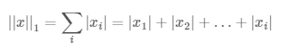
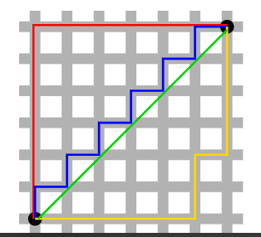
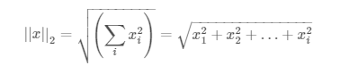
Normalize Data
L1 – Lasso Regression – sum of absolute values of all features
L2 – Ridge Regression – Euclidian distance

Slide 31
Normalize Data
Robustness => L1 > L2
Robustness is defined as resistance to outliers in a dataset. The more able a model is to ignore extreme values in the data, the more robust it is
Stability: L2 > L1
Stability is defined as resistance to horizontal adjustments

Slide 32
Binarize Data
Binarize data (set feature values to 0 or 1) according to a threshold
Values greater than the threshold map to 1, while values less than or equal to the threshold map to 0. With the default threshold of 0, only positive values map to 1.
Binarization is a common operation on text count data where the analyst can decide to only consider the presence or absence of a feature rather than a quantified number of occurrences for instance

Slide 33
Label Encoding
Binarize data (set feature values to 0 or 1) according to a threshold
Values greater than the threshold map to 1, while values less than or equal to the threshold map to 0. With the default threshold of 0, only positive values map to 1.
Binarization is a common operation on text count data where the analyst can decide to only consider the presence or absence of a feature rather than a quantified number of occurrences for instance

